Slide 1
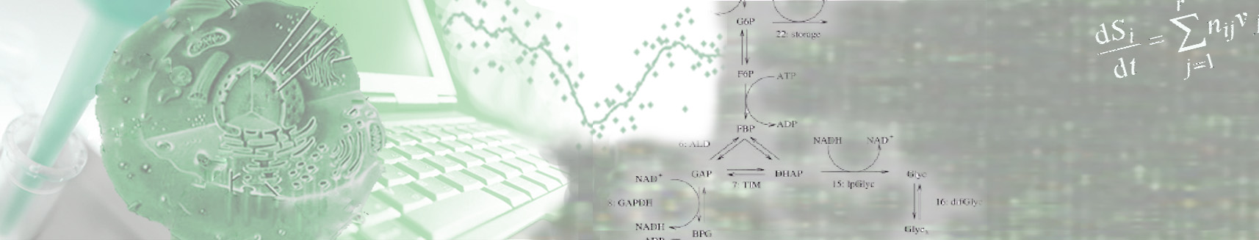
Wintersemester 2016
Fachkurs – Introduction
Edda Klipp
Humboldt-Universität zu Berlin
Institut für Biologie
Theoretische Biophysik

Slide 2
Content
Language?
Script
Time table
Papers to chose

Slide 3
Time Table
Dienstag, 22.11.2016 |  |  | Dienstag, 29.11.2016
10.00-11.30 | Introduction | Edda | 10.00-11.30 | How to write | Edda
12.30-14.00 | Copasi Intro | Judith/Katja | 12.30-14.00 | Presentation Techniques | Judith
14.15-15.45 | Copasi Exercise | Judith/Katja | 14.15-15.45 | Project work | -
16.00-17.30 | Copasi Exercise | Judith/Katja | 16.00-17.30 | Project work | -
Mittwoch, 23.11.2016 |  |  | Mittwoch, 30.11.2016
10.00-11.30 | Copasi: Goldbeter Intro | Judith/Katja | 10.00-11.30 | Project Work | -
12.30-14.00 | Copasi: Goldbeter Implementation | Judith/Katja | 12.30-14.00 | Project Work | -
14.15-15.45 | SBML & Databases | Jannis | 14.15-15.45 | Project Work | -
16.00-17.30 | Python Intro | Jannis/Björn | 16.00-17.30 | Project Work | -
Donnerstag, 24.11.2016 |  |  | Donnerstag, 01.12.2016
10.00-11.30 | Python Intro | Jannis/Björn | 10.00-11.30 | Project Work | -
12.30-14.00 | Python Numpy/Scipy | Jannis/Wolfgang | 12.30-14.00 | Project Work | -
14.15-15.45 | Python Numpy/Scipy | Jannis/Wolfgang | 14.15-15.45 | Project Work | -
16.00-17.30 | Python Plotting | Max | 16.00-17.30 | Project Work | -
Freitag, 25.11.2016 |  |  | Freitag, 02.12.2016
10.00-11.30 | Python Datenanalyse | Jannis/Björn | 10.00-11.30 | Project Presentations | all
12.30-14.00 | Python Datenanalyse | Jannis/Björn | 12.30-14.00 | Project Presentations | all
14.15-15.45 | Python ODE | Max/Wolfgang | 14.15-15.45 | Project Presentations | all
16.00-17.30 | Python ODE | Max/Wolfgang | 16.00-17.30 | Project Presentations | all

Slide 4
Own Contribution
Talk – Presentation of a publication and own simulations
Read and understand paper
Create the presented model, using SBML/Copasi or Python
Reproduce the simulations shown in the publication
Analysis and modification of the model
- Which analyses are made by the authors?
- Does the model change with parameter changes?
- Own ideas for model analysis or model improvement?
Analysis of model presentation
- is it possible to reproduce the model from the information
given in the paper?
6. Preparation of presentation
- Summary of the paper
- Presentation of own results

Slide 5
Own contribution
Talk – Presentation of a publication and own simulations
Form groups of 2 students (in case biophysicists/non-biophysicists)
Time is foreseen in time table
Every paper is connected to a mentor. Contact them!!!

Slide 6
Structure of presentation
Front page – presenters, publication (Title, authors)
Summary of the publication
Summary of open questions and problems
Presentation of own simulations including problems/implementation
Summary and conclusions
Acknowledgement (to mentor, in case fellow students)

Slide 7
Andrea Auconi

Slide 8
Roman Rainer

Slide 9
Josch Pauling

Slide 10
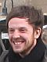
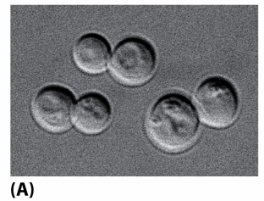
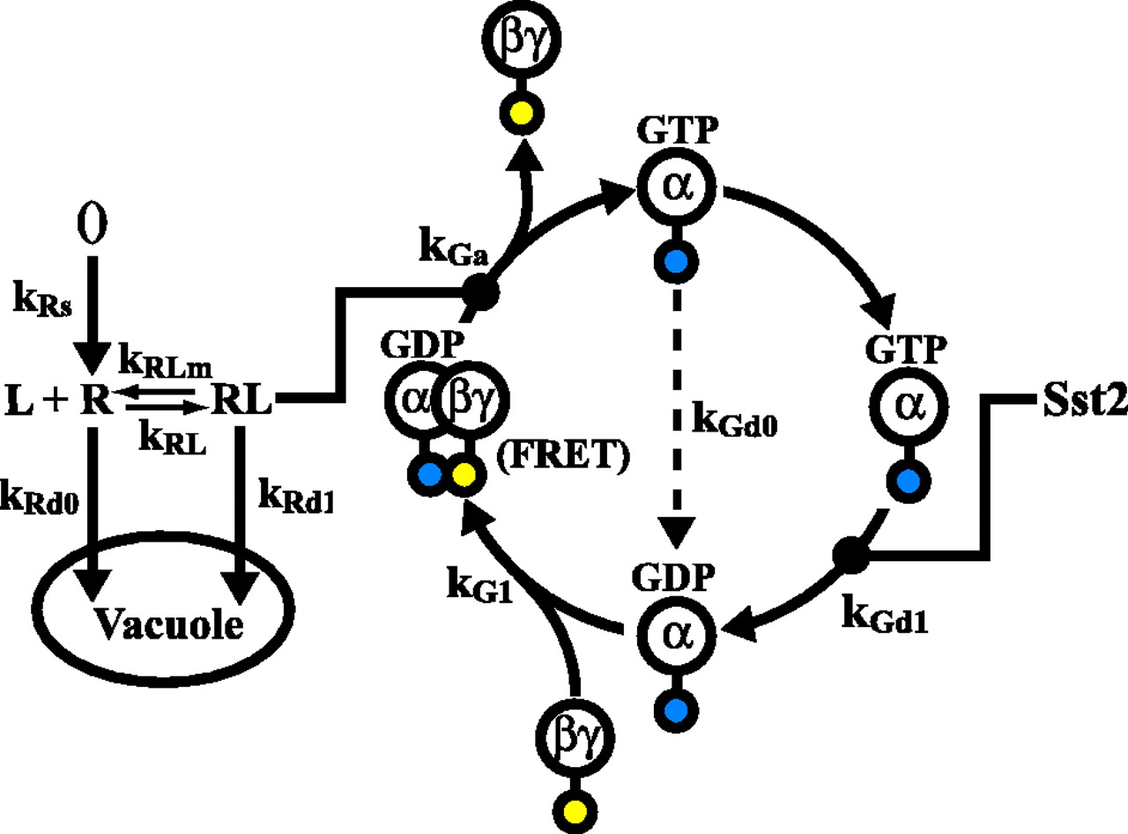
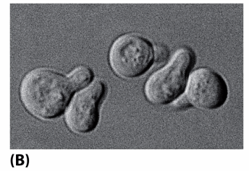
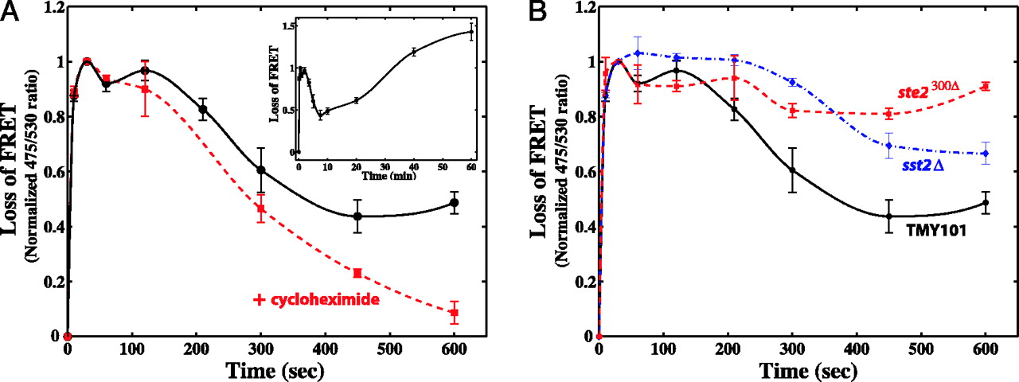
Wolfgang Giese
A quantitative characterization of the yeast heterotrimeric G protein cycle
Tau-Mu Yi, Hiroaki Kitano, Melvin Simon – PNAS 2003
Reaction diagram of heterotrimeric G protein cycle.
Shmooing yeast cells
ToDo:
- Understand the model of the G-protein cycle
and corresponding FRET experiments
- Implement the model based on ODEs in Python/Copasi
- Analyze the model and compare your simulations
with experiments
Tutor: Wolfgang, Room 502
wolfgang.giese@biologie.hu-berlin.de
Kinetics of G protein activation.

Slide 11
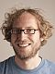
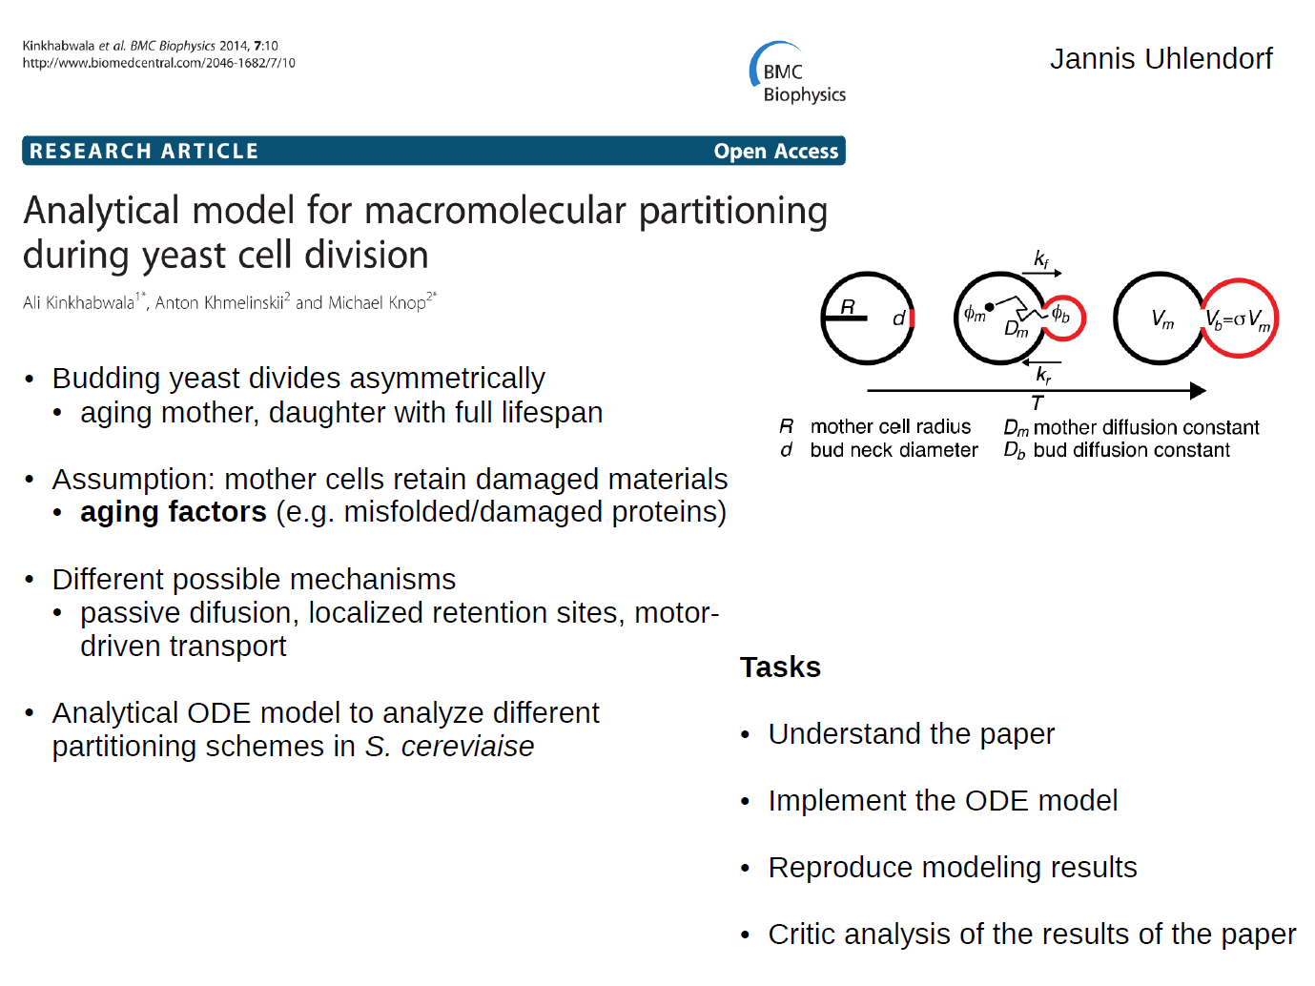
Jannis Uhlendorf

Slide 12
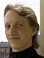
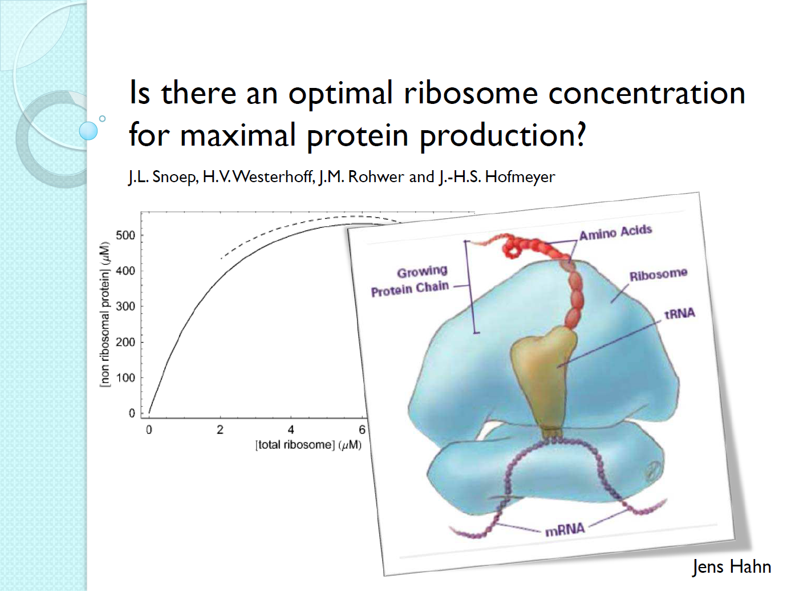
Jens Hahn

Slide 13
Julia Katharina Schlichting

Slide 14
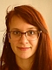
Ana Bulovic

Slide 15
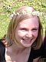
Katja Tummler

Slide 16
Friedemann Uschner

Slide 17
Friedemann Uschner

Slide 18
Tasks
Read and understand the paper
Implement the model
Do the perturbation experiments
Implement different input signal for different mutations – explain the outcome

Slide 19
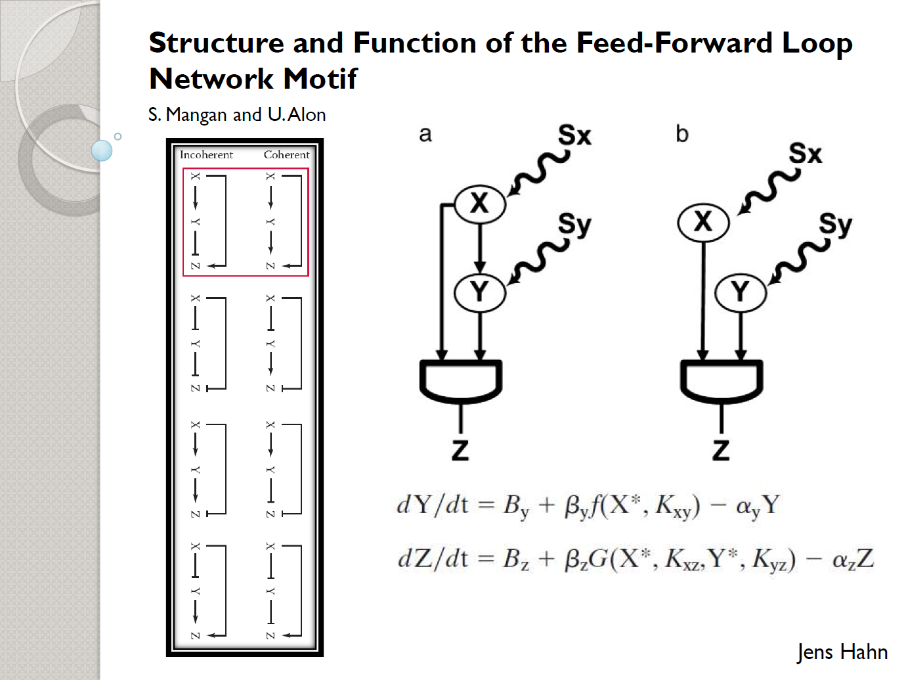
Jens Hahn

